Slide 1


Slide 2
Details
Mailing Address:- shop-4, Survey no.14/4b, Sinhagad Road, Pune, Maharashtra.
Email Address:- acexpertzpune@gmail.com
Contact Persons Name:- Atul Kulkarni
Contact Number:- 8087032450
Work Phone Number:- 8975981419

Slide 3
Business Requirements
User Requirements
To ease the whole installation process of AC.
To give the feedback to owner in more easier way.
To ensure that he has given the right amount to the salesman.
To know the AC is correctly installed or not.
To keep owner updated about the current scenario without actually need of talking with him.

Slide 4
Owner Requirement
An app which will help customers to fill the details after the installation of the AC.
An app will which will keep the owner updated about the current scenario at the customers side.

Slide 5
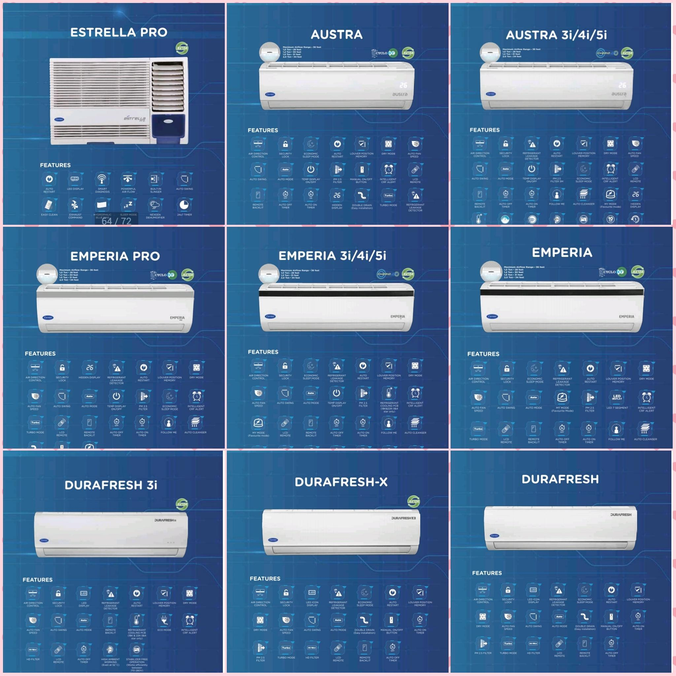
A glimpse at the products they sell...

Slide 6
Functional Requirements(Business Process)
-The app should take input from customer and send the details to the owner.
Non-Functional Requirements(Validation)
-It should take correct data from the customer and the process should be secure.
-The customer should be validated.

Slide 7
Proposed Solution
List of modules
Login page for admin
About us (Information about shop)
Update Information
Services
Contact Information

Slide 8
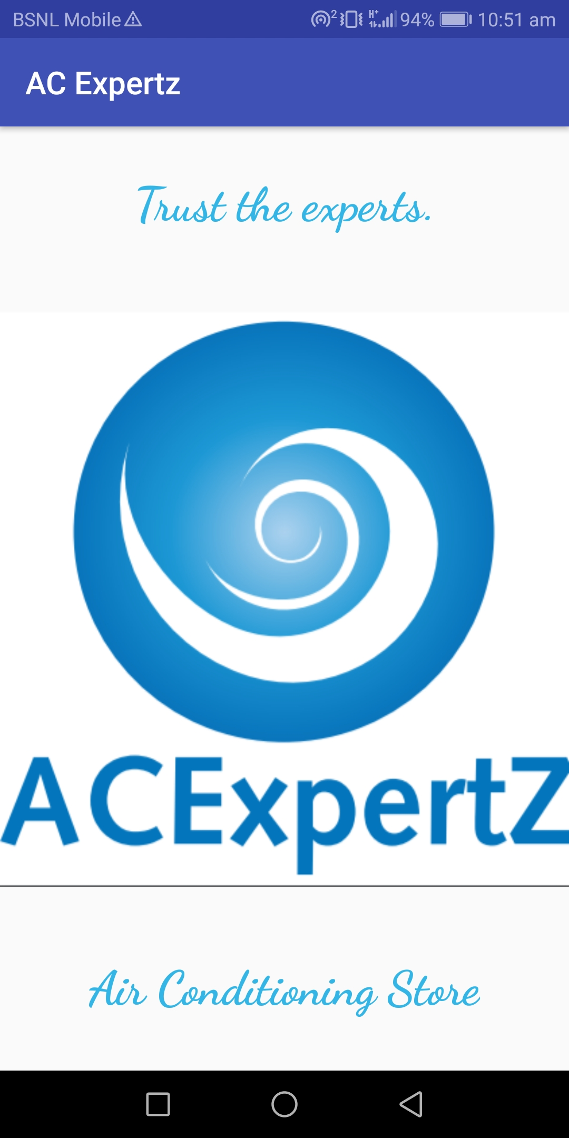

Slide 9
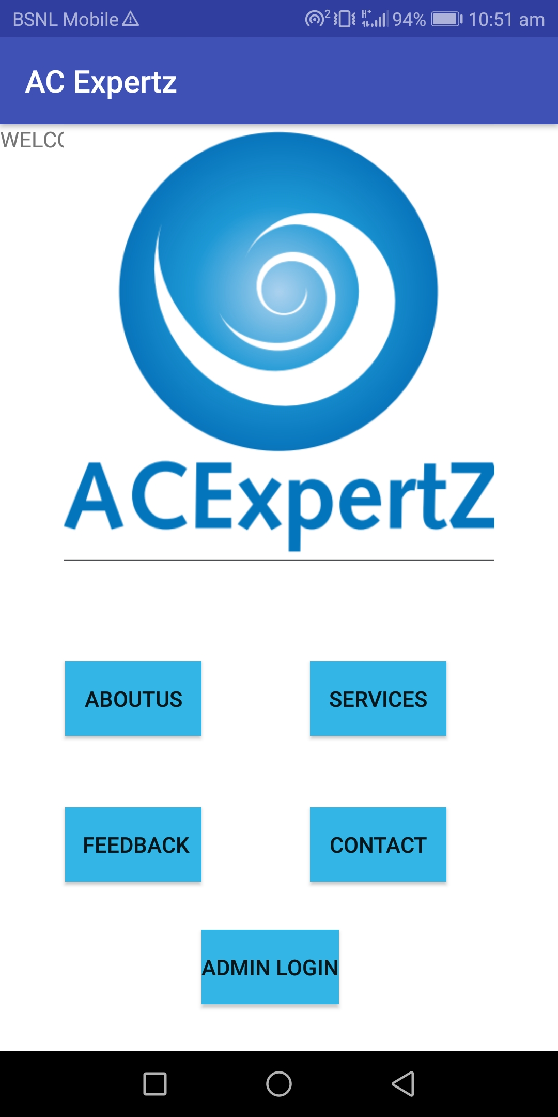

Slide 10
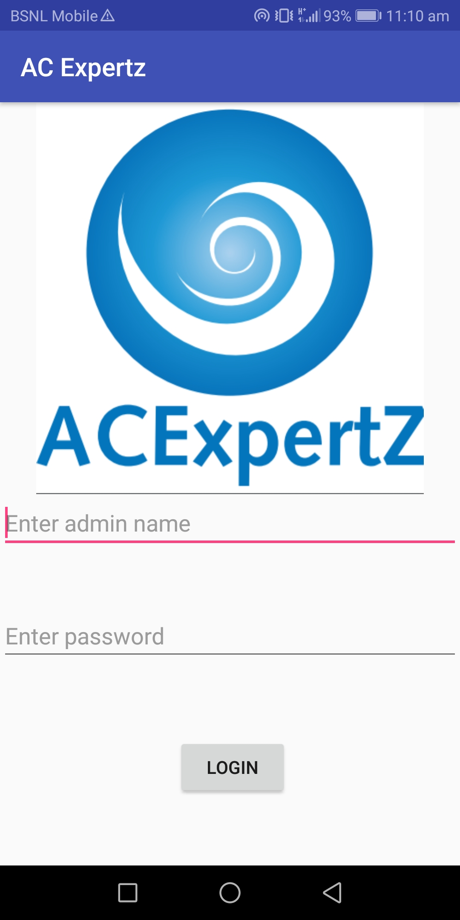

Slide 11
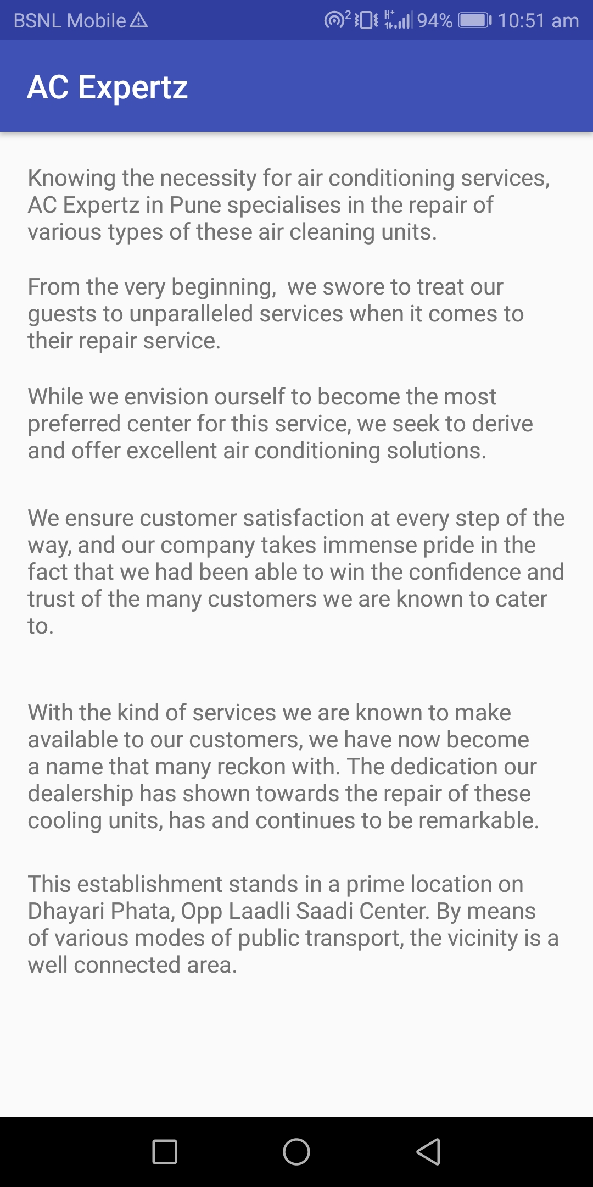
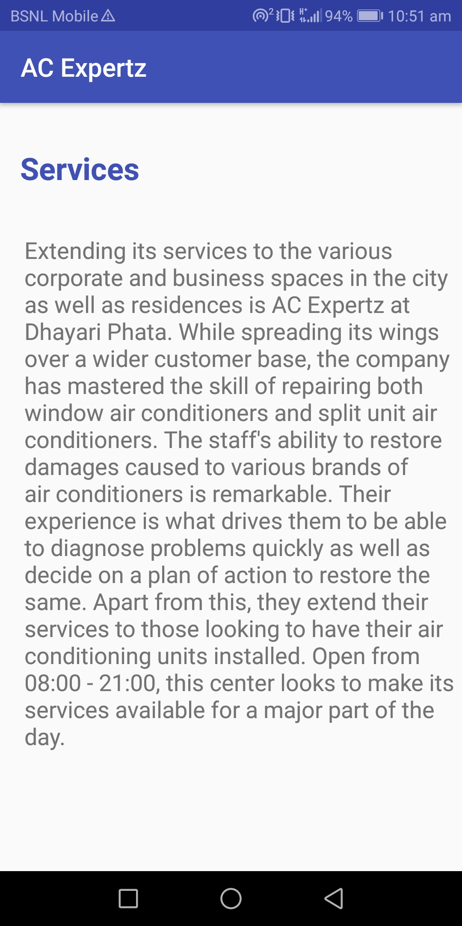

Slide 13
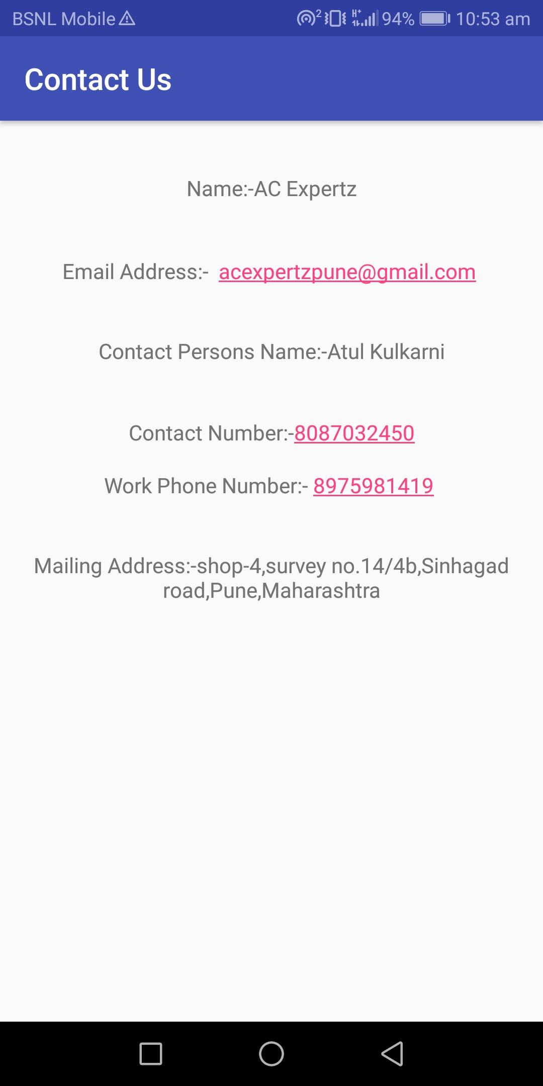

Slide 14
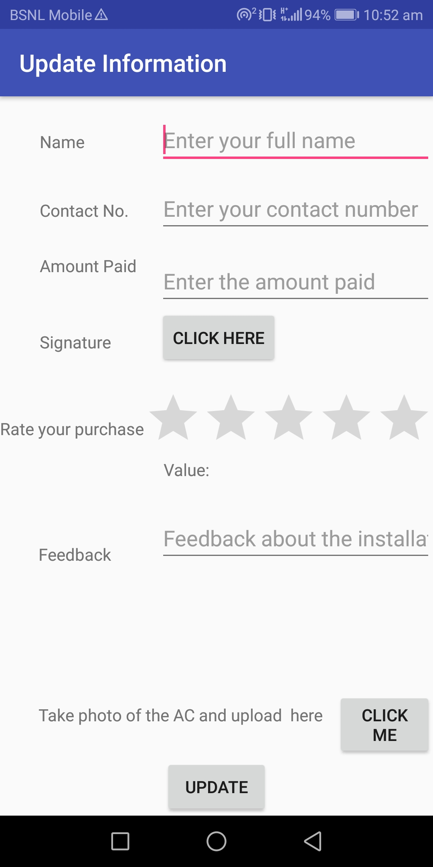

Slide 15
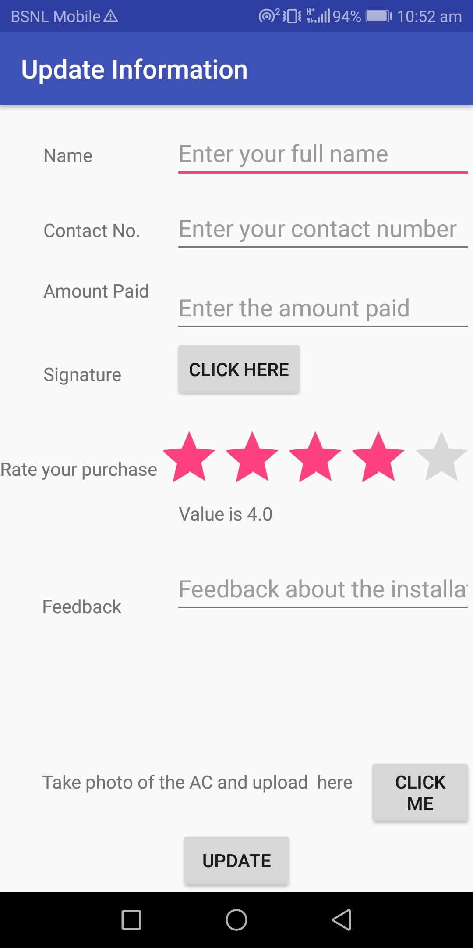

Slide 16
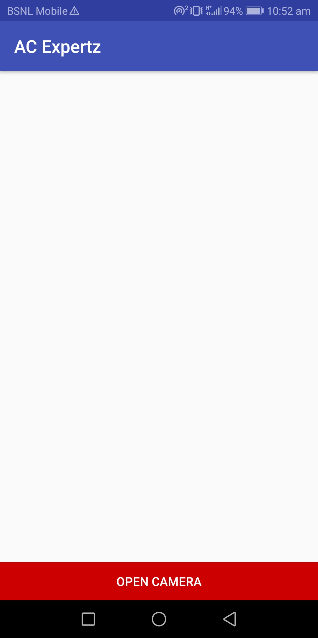

Slide 17
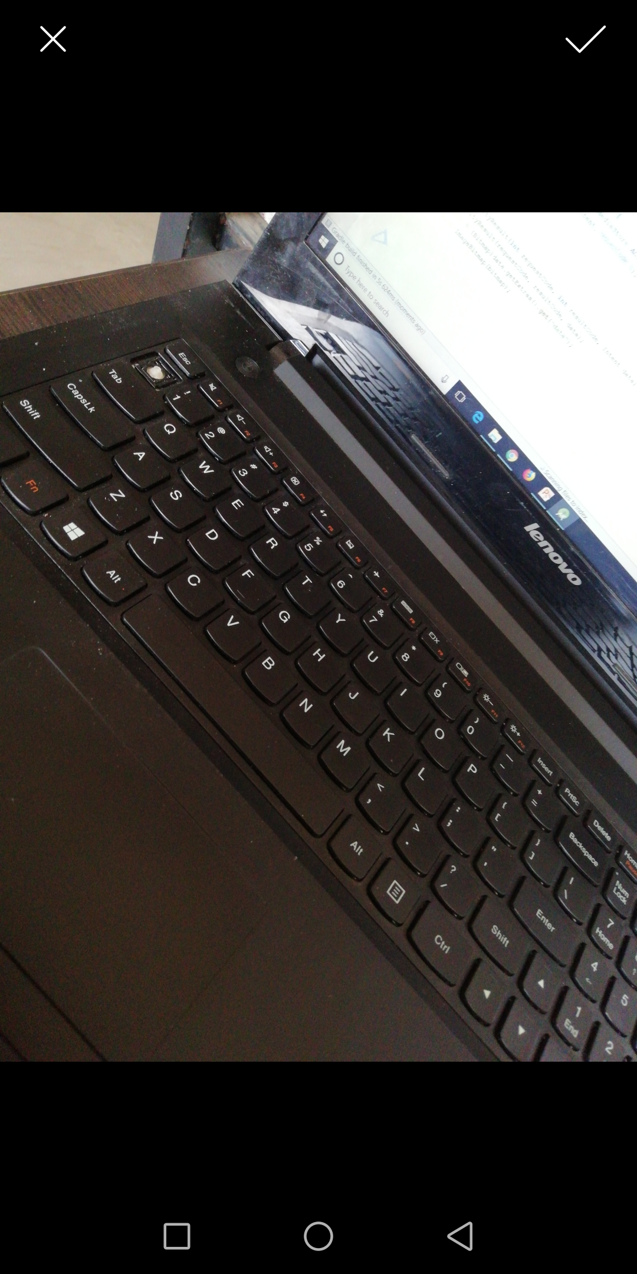

Slide 18
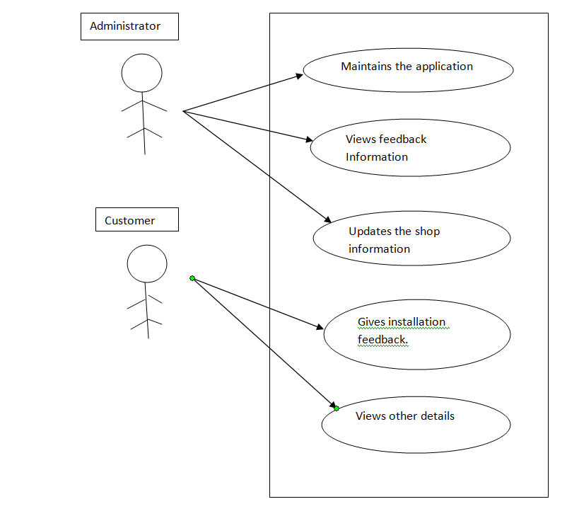
Usecase Diagram

Slide 19
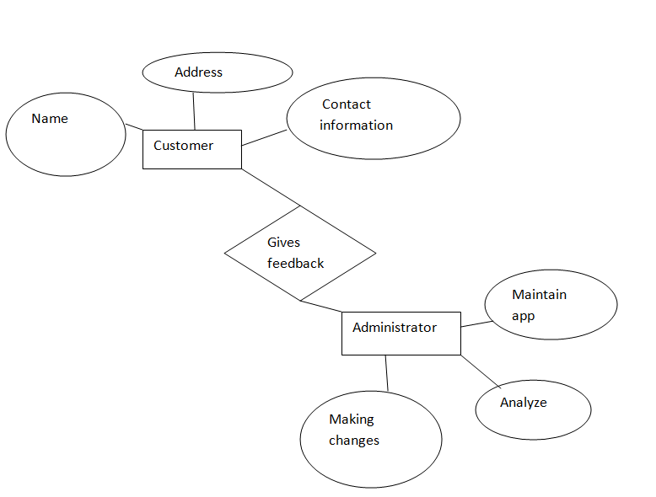
ER diagram

Slide 20
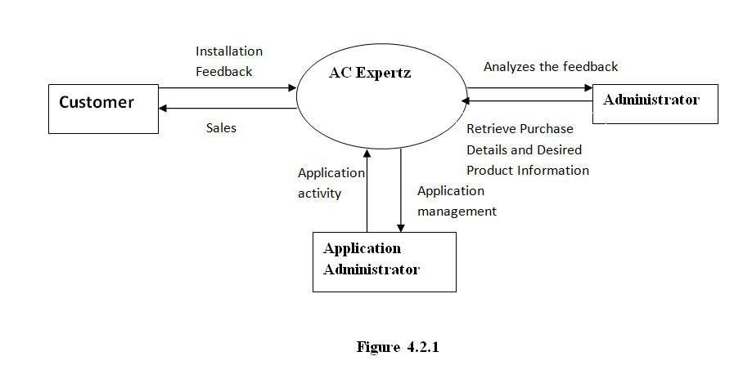
Data flow diagram

Slide 21
Thank you..

